Slide 1
Snooping Cache Coherence Protocols

Slide 2
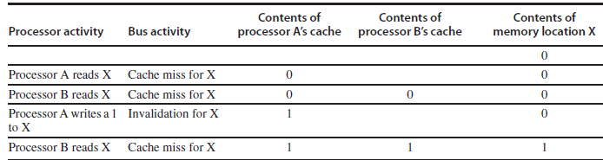
Snooping Cache Coherence Protocols
There are two ways to maintain the coherence requirement.
One method is to ensure that a processor has exclusive access to a data item before it writes that item. This style of protocol is called a write invalidate protocol because it invalidates other copies on a write.
It is by far the most common protocol. Exclusive access ensures that no other readable or writable copies of an item exist when the write occurs: All other cached copies of the item are invalidated.
The following figure shows an example of an invalidation protocol with write-back caches in action.

Slide 3
Snooping Cache Coherence Protocols
To see how this protocol ensures coherence, consider a write followed by a read by another processor: Since the write requires exclusive access, any copy held by the reading processor must be invalidated (hence, the protocol name).
Thus, when the read occurs, it misses in the cache and is forced to fetch a new copy of the data.
For a write, we require that the writing processor have exclusive access, preventing any other processor from being able to write simultaneously.
If two processors do attempt to write the same data simultaneously, one of them wins the race, causing the other processor’s copy to be invalidated.
For the other processor to complete its write, it must obtain a new copy of the data, which must now contain the updated value. Therefore, this protocol enforces write serialization.
The alternative to an invalidate protocol is to update all the cached copies of a data item when that item is written. This type of protocol is called a write update or write broadcast protocol.

Slide 4
Snooping Cache Coherence Protocols
Because a write update protocol must broadcast all writes to shared cache lines, it consumes considerably more bandwidth. For this reason, recent multiprocessors have opted to implement a write invalidate protocol.
Basic Implementation Techniques
To perform an invalidate, the processor simply acquires bus access and broadcasts the address to be invalidated on the bus.
All processors continuously snoop on the bus, watching the addresses.
The processors check whether the address on the bus is in their cache. If so, the corresponding data in the cache are invalidated.
When a write to a block that is shared occurs, the writing processor must acquire bus access to broadcast its invalidation.
If two processors attempt to write shared blocks at the same time, their attempts to broadcast an invalidate operation will be serialized when they arbitrate for the bus.

Slide 5
Snooping Cache Coherence Protocols
Basic Implementation Techniques
The first processor to obtain bus access will cause any other copies of the block it is writing to be invalidated.
If the processors were attempting to write the same block, the serialization enforced by the bus also serializes their writes.
All coherence schemes require some method of serializing accesses to the same cache block, either by serializing access to the communication medium or another shared structure.
In addition to invalidating outstanding copies of a cache block that is being written into, we also need to locate a data item when a cache miss occurs.
In a write-through cache, it is easy to find the recent value of a data item, since all written data are always sent to the memory, from which the most recent value of a data item can always be fetched.

Slide 6
Snooping Cache Coherence Protocols
Basic Implementation Techniques
For a write-back cache, the problem of finding the most recent data value is harder, since the most recent value of a data item can be in a private cache rather than in the shared cache or memory.
Write-back caches can use the snooping scheme both for cache misses and for writes: Each processor snoops every address placed on the shared bus.
If a processor finds that it has a dirty copy of the requested cache block, it provides that cache block in response to the read request and causes the memory (or L3) access to be aborted.
The additional complexity comes from having to retrieve the cache block from another processor’s private cache (L1 or L2), which can often take longer than retrieving it from L3.
Since write-back caches generate lower requirements for memory bandwidth, they can support larger numbers of faster processors.
The normal cache tags can be used to implement the process of snooping, and the valid bit for each block makes invalidation easy to implement.

Slide 7
Snooping Cache Coherence Protocols
Basic Implementation Techniques
For writes, if there are no other cached copies, then the write need not be placed on the bus in a write-back cache.
Not sending the write reduces both the time to write and the required bandwidth.
To track whether or not a cache block is shared, we can add an extra state bit associated with each cache block, just as we have a valid bit and a dirty bit.
By adding a bit indicating whether the block is shared, we can decide whether a write must generate an invalidate.
When a write to a block in the shared state occurs, the cache generates an invalidation on the bus and marks the block as exclusive.
The core with the sole copy of a cache block is normally called the owner of the cache block.

Slide 8
Snooping Cache Coherence Protocols
Basic Implementation Techniques
When an invalidation is sent, the state of the owner’s cache block is changed from shared to unshared (or exclusive). If another processor later requests this cache block, the state must be made shared again.
An example protocol
The simple protocol we consider has three states: invalid, shared, and modified.
The shared state indicates that the block in the private cache is potentially shared, while the modified state indicates that the block has been updated in the private cache; note that the modified state implies that the block is exclusive.
This protocol is for a write-back cache

Slide 9
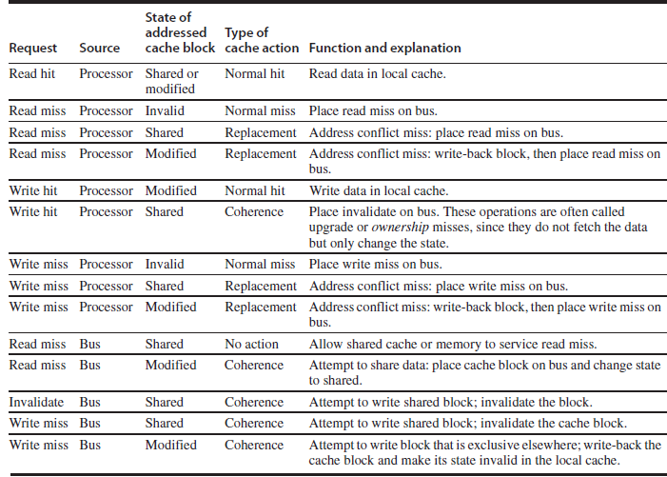

Slide 10
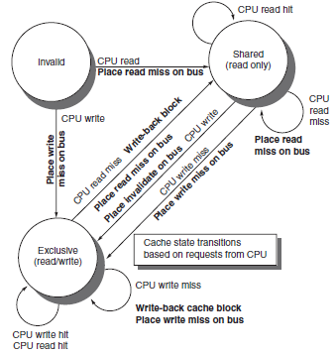

Slide 11
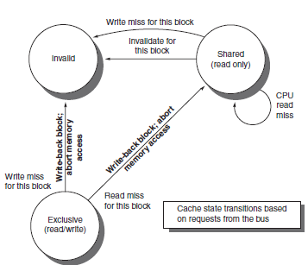

Slide 12
Snooping Cache Coherence Protocols
When an invalidate or a write miss is placed on the bus, any cores whose private caches have copies of the cache block invalidate it.
For a write miss in a write-back cache, if the block is exclusive in just one private cache, that cache also writes back the block; otherwise, the data can be read from the shared cache or memory.
Any transition to the exclusive state (which is required for a processor to write to the block) requires an invalidate or write miss to be placed on the bus, causing all local caches to make the block invalid.
In addition, if some other local cache had the block in exclusive state, that local cache generates a write-back, which supplies the block containing the desired address.
Finally, if a read miss occurs on the bus to a block in the exclusive state, the local cache with the exclusive copy changes its state to shared.

Slide 13
Snooping Cache Coherence Protocols
Extensions to the Basic Coherence Protocol
The popular MESI protocol, which is named for the four states it includes (Modified, Exclusive, Shared, and Invalid). It adds the state Exclusive to the basic MSI protocol to indicate when a cache block is resident only in a single cache but is clean.
MOESI adds the state Owned to the MESI protocol to indicate that the associated block is owned by that cache and out-of-date in memory.

Slide 14
Limitations in Symmetric Shared-Memory Multiprocessors and Snooping Protocols
As the number of processors in a multiprocessor grows, or as the memory demands of each processor grow, any centralized resource in the system can become a bottleneck.
Using the higher bandwidth connection available on-chip and a shared L3 cache, which is faster than memory, designers have managed to support four to eight high-performance cores in a symmetric fashion. Such an approach is unlikely to scale much past eight cores, and it will not work once multiple multicores are combined.
Snooping bandwidth at the caches can also become a problem, since every cache must examine every miss placed on the bus.
  duplicating the tags is one solution.
  Another approach is to place a directory at the level of the outermost cache.

Slide 15
To increase the communication bandwidth between processors and memory, designers have used multiple buses as well as interconnection networks, such as crossbars or small point-to-point networks
The memory system can be configured into multiple physical banks,
  It boosts the effective memory bandwidth while retaining uniform access time to memory.

Slide 16
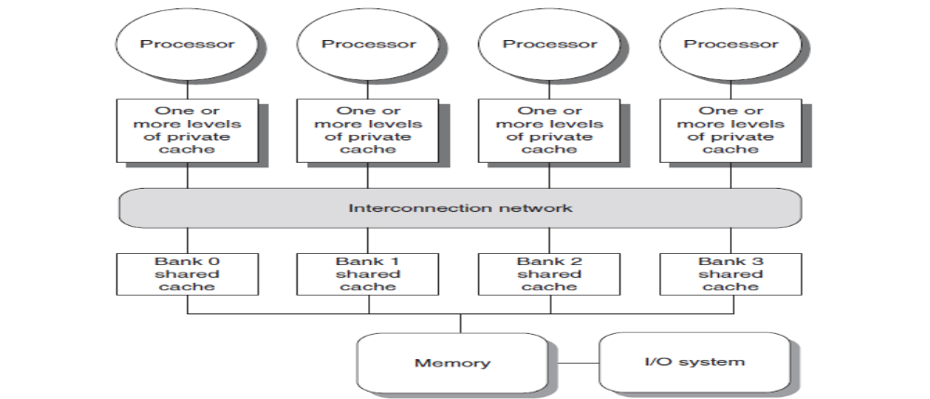
A multicore single-chip multiprocessor with interconnection network

Slide 17
A snooping cache coherence protocol can be used without a centralized bus, but still requires that a broadcast be done to snoop the individual caches on every miss to a potentially shared cache block.
cache coherence traffic creates another limit on the scale and the speed of the processors
  coherence traffic is unaffected by larger caches, faster processors will inevitably overwhelm the network and the ability of each cache to respond to snoop requests from all the other caches

